Slide 1








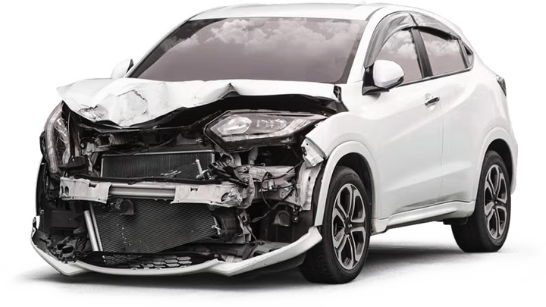
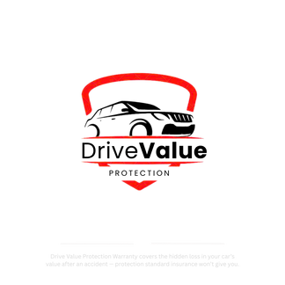
Diminished
Value
Protection
Car value protection you can count on when it matters most.
ACCIDENT COVERAGE
VALUE
Our Car Value Protection plan safeguards your vehicle’s worth by covering the hidden losses standard insurance often overlooks, giving you lasting confidence on the road.
DriveValue
Protection
www.drivevalueprotection.net | (561) 213-3324

